Slide 1
Digital signal processing to increase resolution and efficiency of inelastic instruments
DSP is known method of improving efficiency of data acquisition instruments.
(standard radar vs modern active phased array radar)
PACE project -- investigation of instrument resolution function
Tobyfit -- the package to use resolution function to help recovering the material’s
dispersion
Objectives:
DSP as alternative way of extracting additional information about scattering process
from the knowledge of an instrument’s resolution function.
Effect of the correlations between the different signal’s components on the total
scattering and the recovery of the material dispersion.

Slide 2
Scattering equation and its solutions in neutron scattering
Analysed within FWFM (full width at half-max) approximation
Tobyfitting would allow some limiting account for resolution function shape.

Slide 3
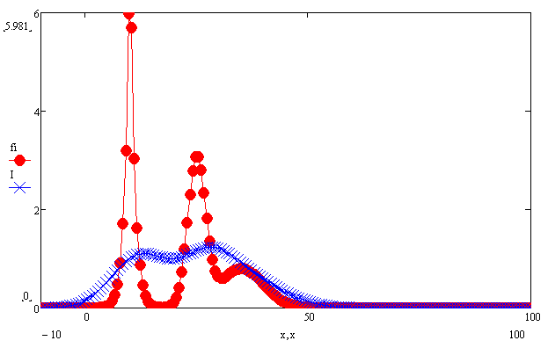
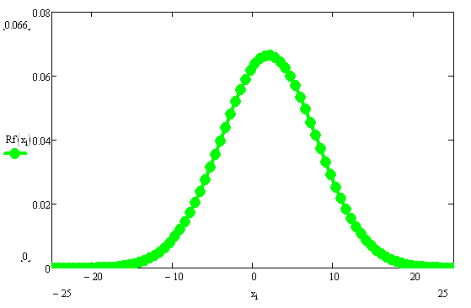
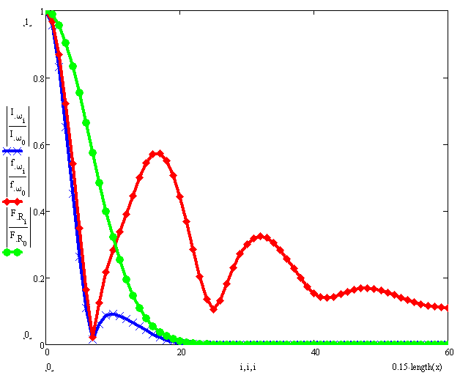
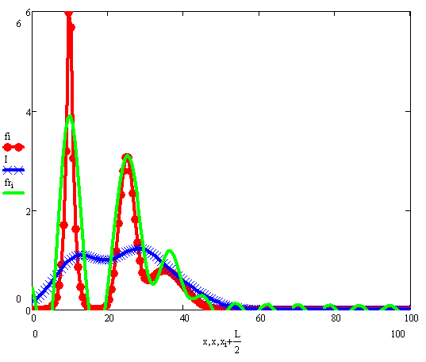
Alternative approach: invert integral equation directly:
1D problem is easy invertible:
Signal to recover S(x)
Resolution function R
Registered signal I(ε)
Spectral intensities for:
Recovered signal
Resolution function
Registered signal I(ε)
Signal to recover
Cut-off frequency

Slide 4
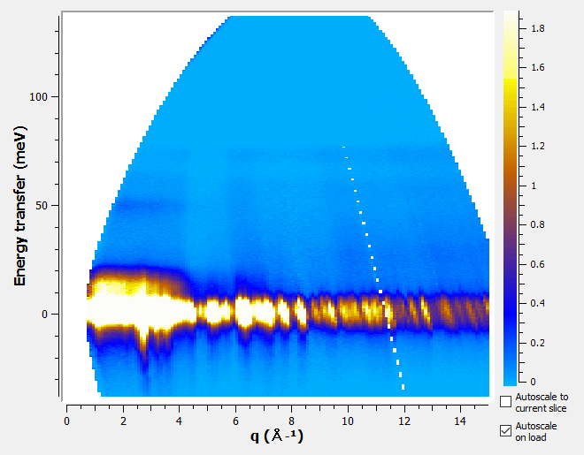
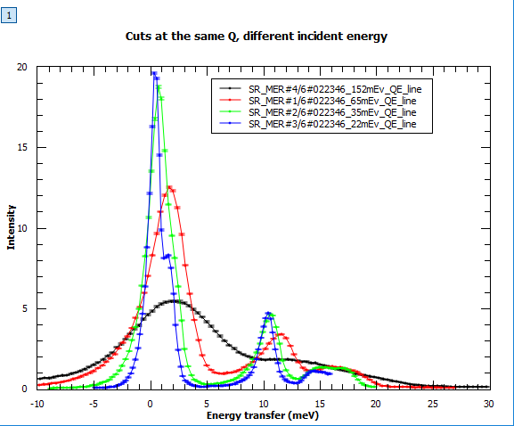
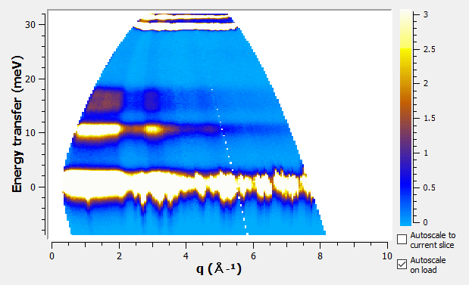
Model experiment. MERLIN, multirep mode, weakly-dispersive system:

Slide 5
Simulated MERLIN Moderator profile with areas selected by chopper:

Slide 6
Time velocity distributions
Neutron’s time-velocity profile
rep 1 after chopper
Moderator profile rep 1 at chopper

Slide 7
Time-velocity distribution Moving pulse from chopper to sample

Slide 8
Time-velocity distribution after inelastic scattering
Neutron’s time-velocity profile
after scattering at sample
Neutron’s time-velocity profile
rep 1 at sample
Time at sample

Slide 9
Velocity profile changes from sample to detector (rep 1)
Neutron’s time-velocity profile
after scattering at sample
Velocity
Velocity
Time at detector
Time at sample

Slide 10
Time profile at a detector:
If no correlations between time and velocity components:
Can be solved as two 1-D inverse Fourier transformations:

Slide 11
Velocity distribution and its recovery using standard data reduction procedure:
-- pulse velocity
-- velocity transfer

Slide 12
Inverting integral equation
Fourier transformation:
Algebraic equation for velocity transfer Fourier components:

Slide 13
Kernel of the matrix equation for the Fourier components
Spectral intensities for:
Resolution function
Registered signal I(ε)
Signal to recover
n
Cut-off frequency
k

Slide 14
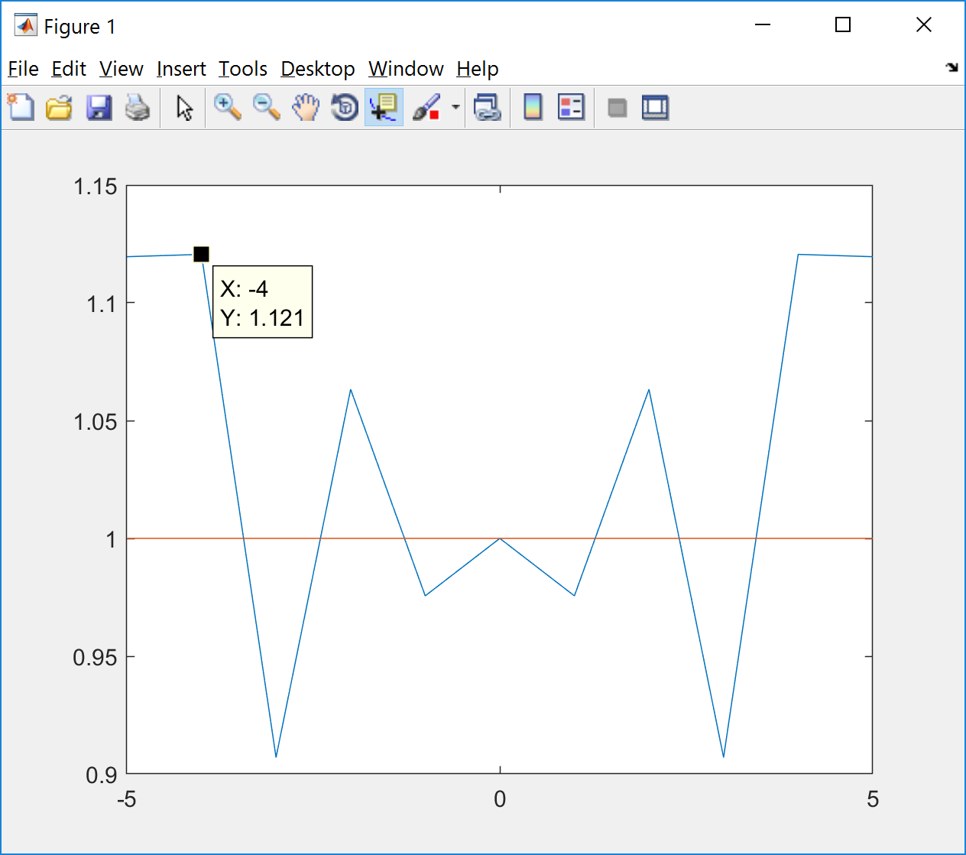
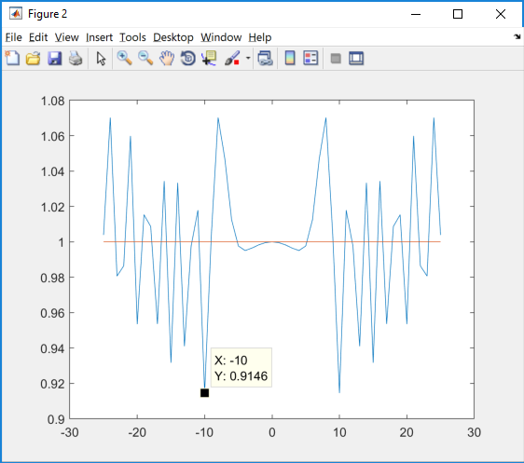
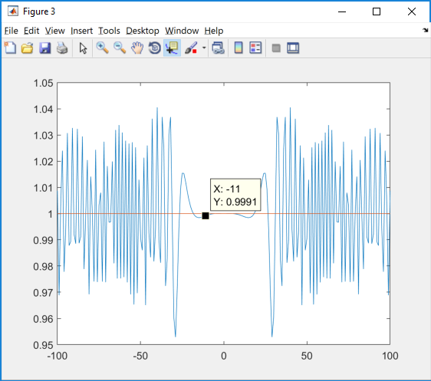
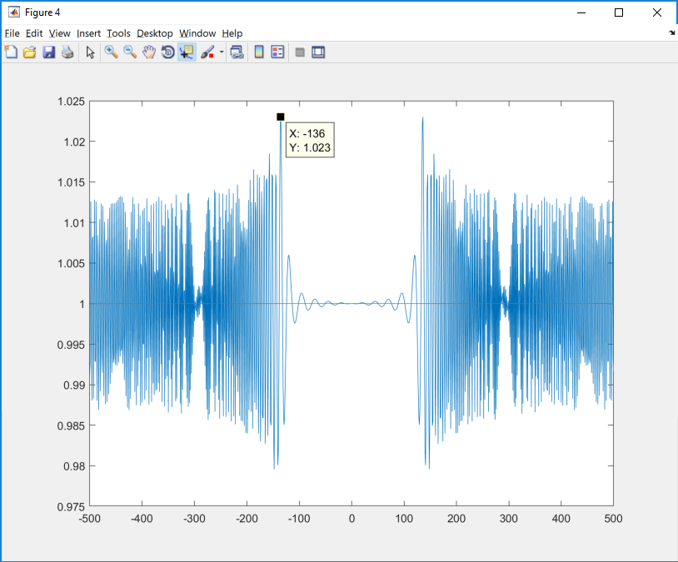
Amplitudes of the integrals:

Slide 15
Recovering scattering signal using deconvolution :
Recovered From results of the
convolution

Slide 16
Recovered distribution, pseudo- streamlines method
No noise

Slide 17
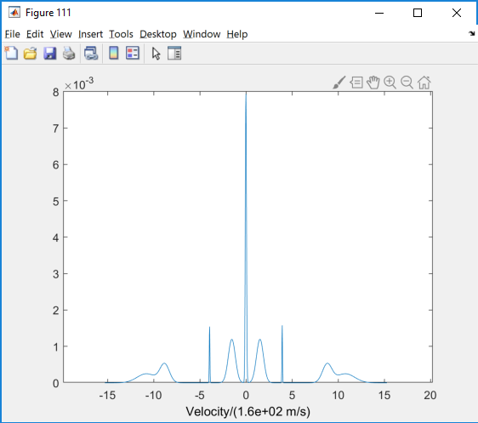
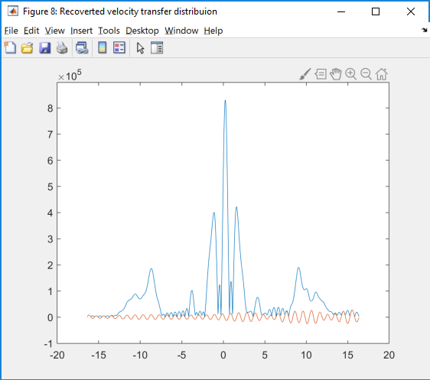
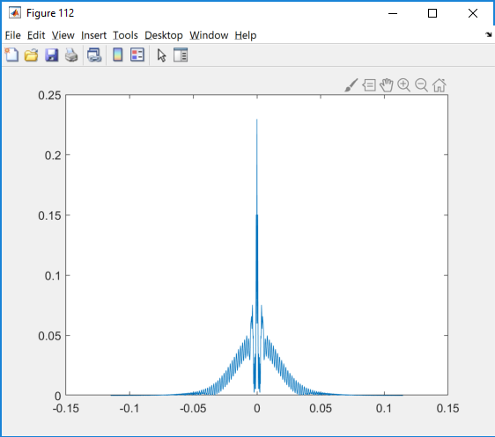
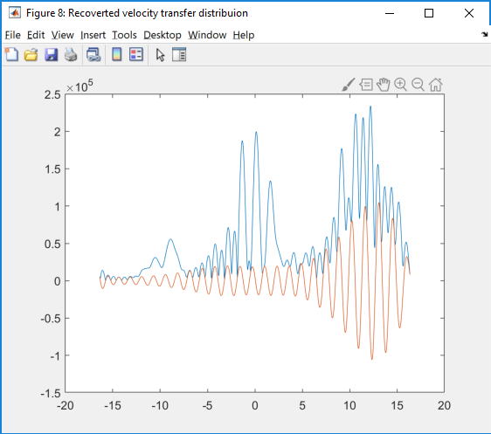
Resolution deconvolution. Direct Fourier Method
No noise
Spectrum
noisy signal

Slide 18
Direct Fourier method InvertPulse3 problem on 10/01/2019 (Invalid phase shift?)

Slide 19
Problems left
Nasty diffraction equation.
Q-dependance
Correct error calculations.
Noise and spurions.
New reduction software package.
k-resolution
Precise measurement of moderator profiles and chopper phase on the fly (MERLIN has problem with this)
Change in chopper packs to allow optimal neutron pules shape.

Slide 20
Conclusion
Knowledge of instrument resolution function and DSP would provide substantial improvement in instrument resolution and beam usage.
More time and efforts needed to make it useful

